Slide 1
Crime Classification
CPSC 531- Advance Database Management
Akshit Trivedi
Mann Gawade
Jainish Shah

Slide 2

Scope
We are created a system that could classify crime description into different categories. It automatically assign a described crime to category which could help law enforcements to assign right officers to crime or could automatically assign officers to crime based on the classification.
Notes:
2

Slide 3





Libraraies Used

Slide 4
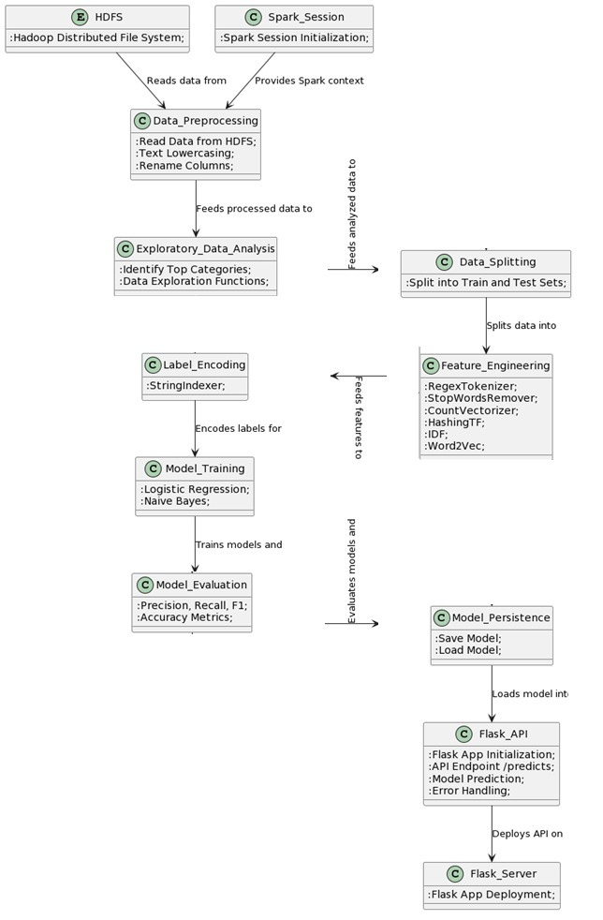
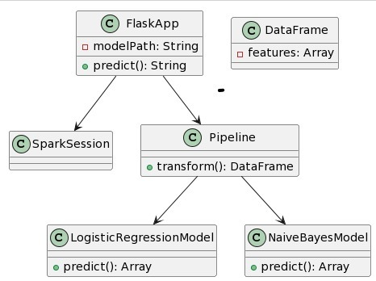
Flow Chart

Slide 5
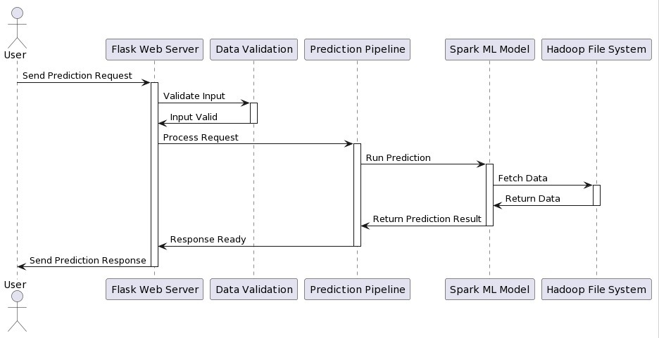
Sequence Digram

Slide 6

Dataset
We are using dataset from Kaggle on San Francisco Crime. Our responsibilty is to train a model based on 39 pre-defined categories, test the model accuracy and deploy it into production. Given a new crime description, the system should assign it to one of 39 categories.
We have 7 coloumns in our dataset –
Dates
Category
Descript
DayOfWeek
PdDistrict
Resolution
Addresss

Slide 7
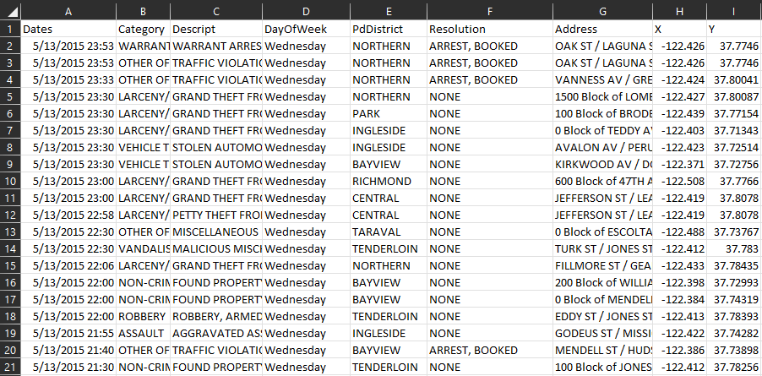
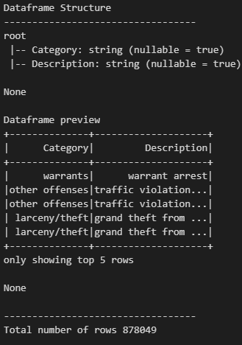
Dataset

Slide 8
Hadoop

Slide 9
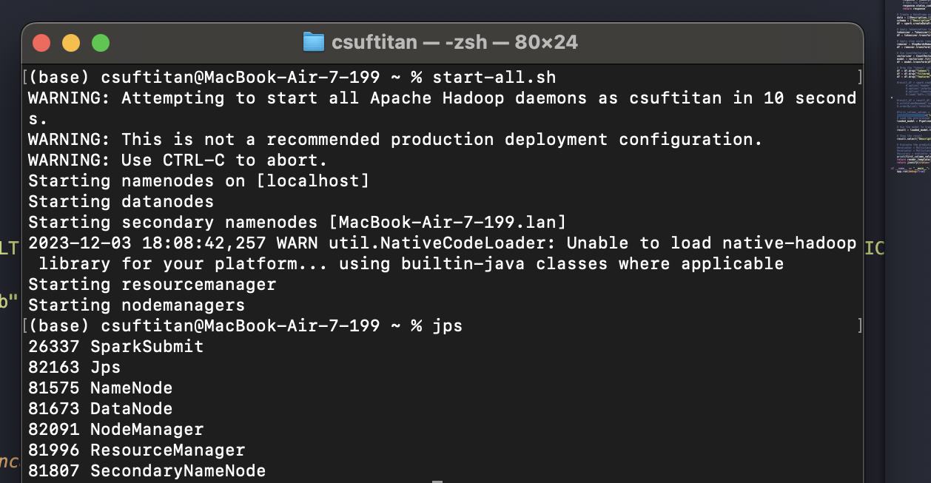

Slide 10
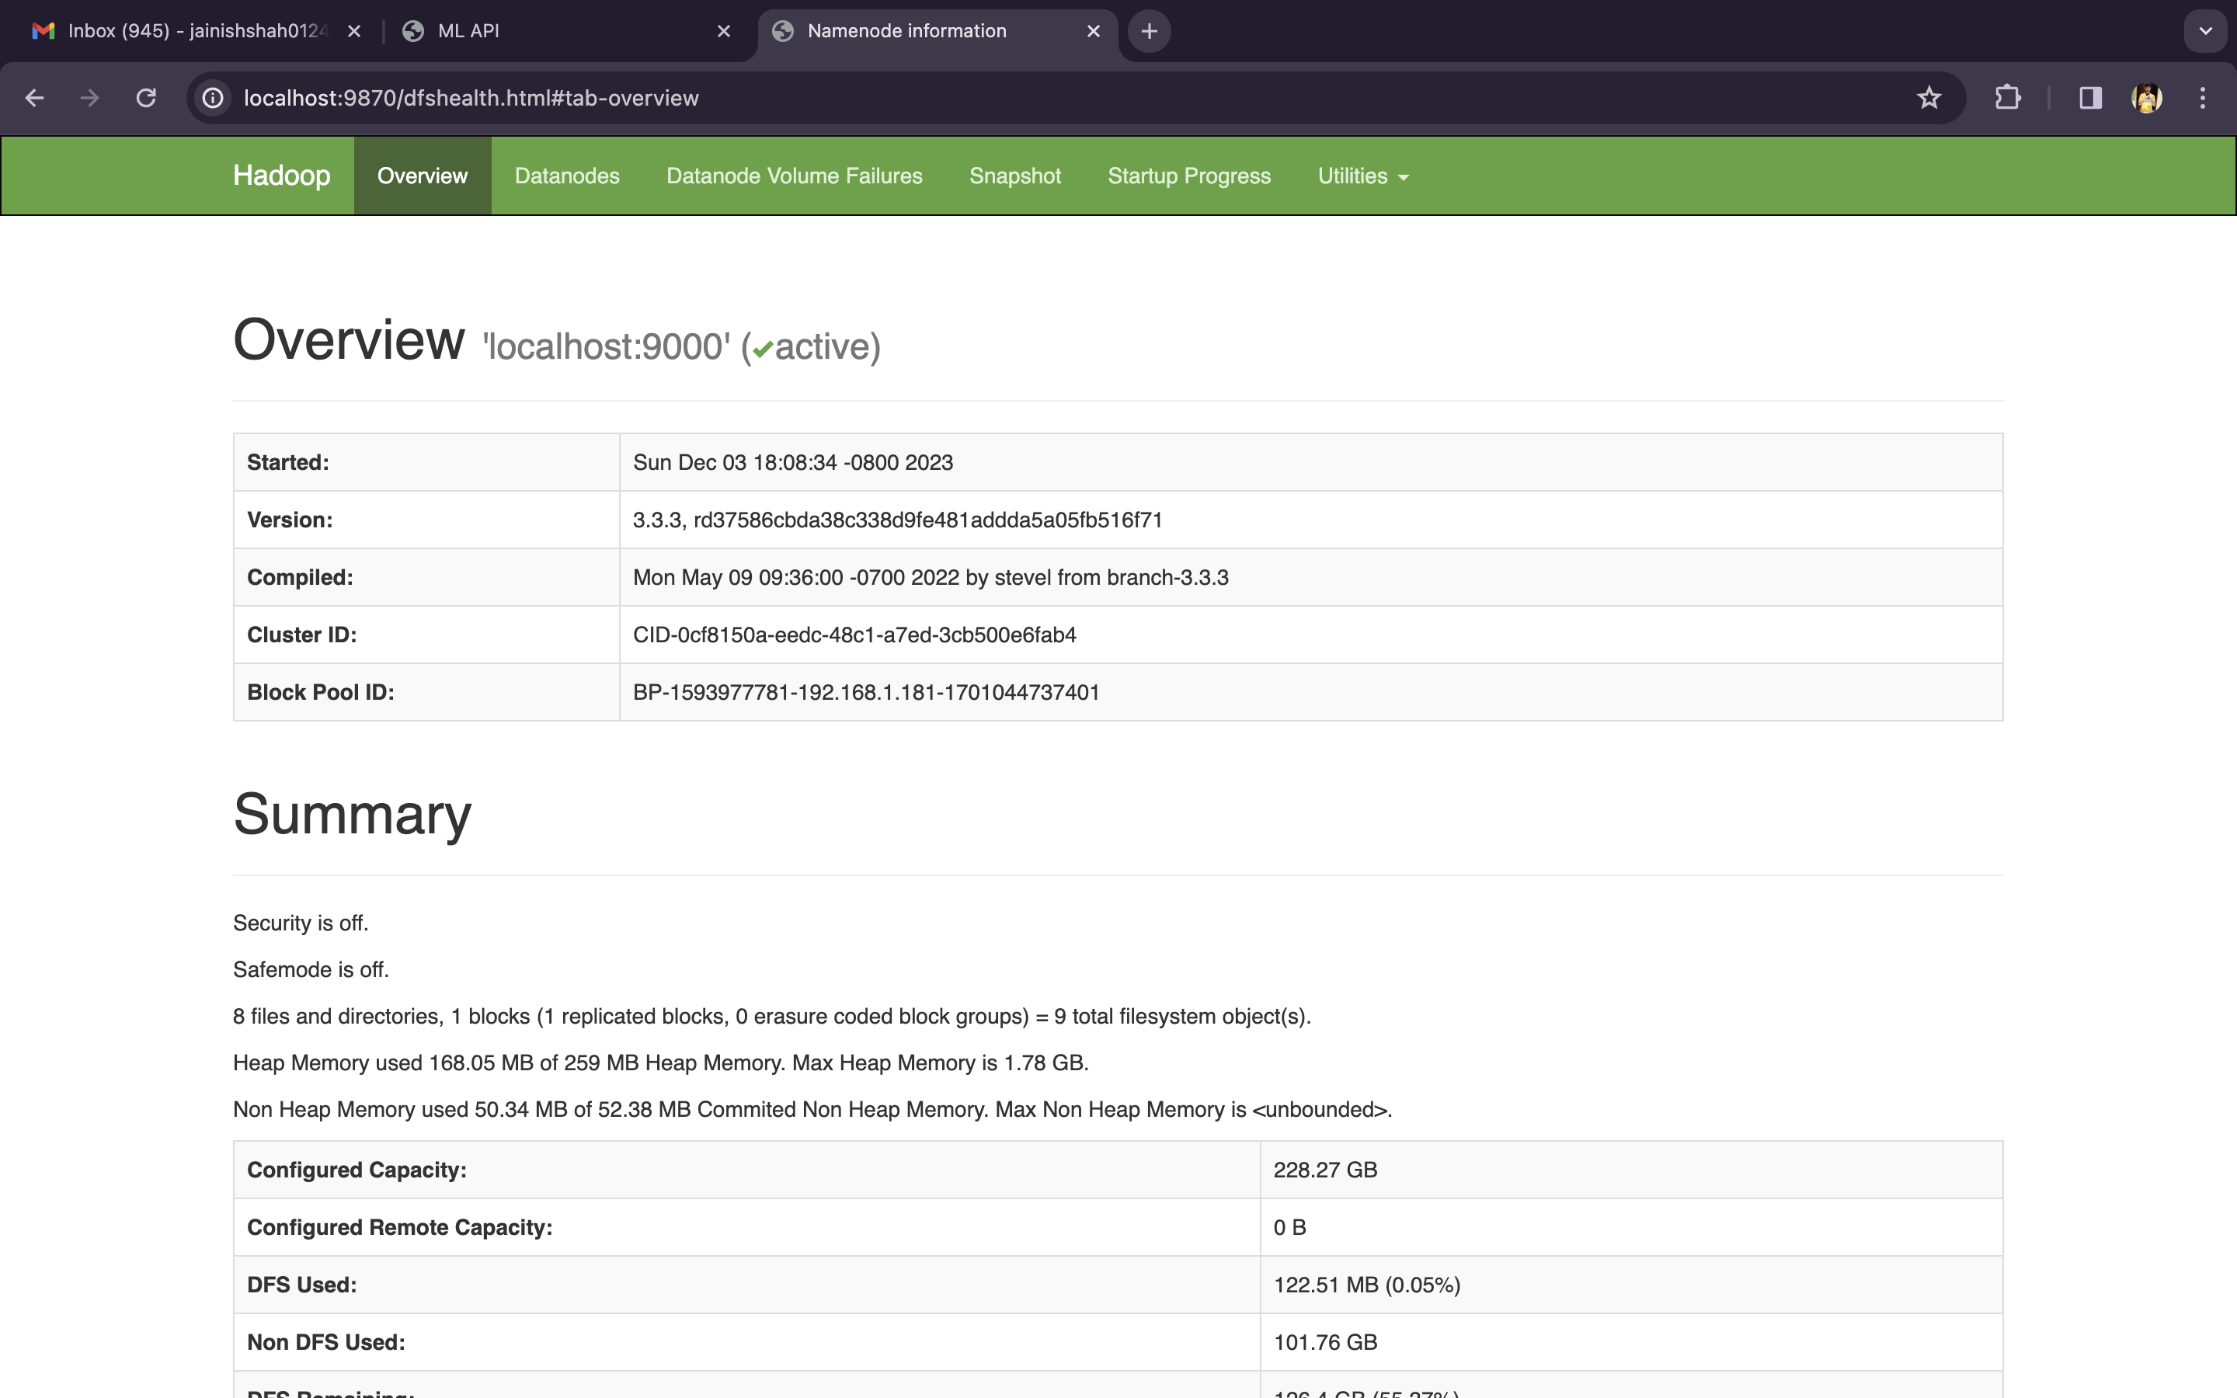

Slide 11
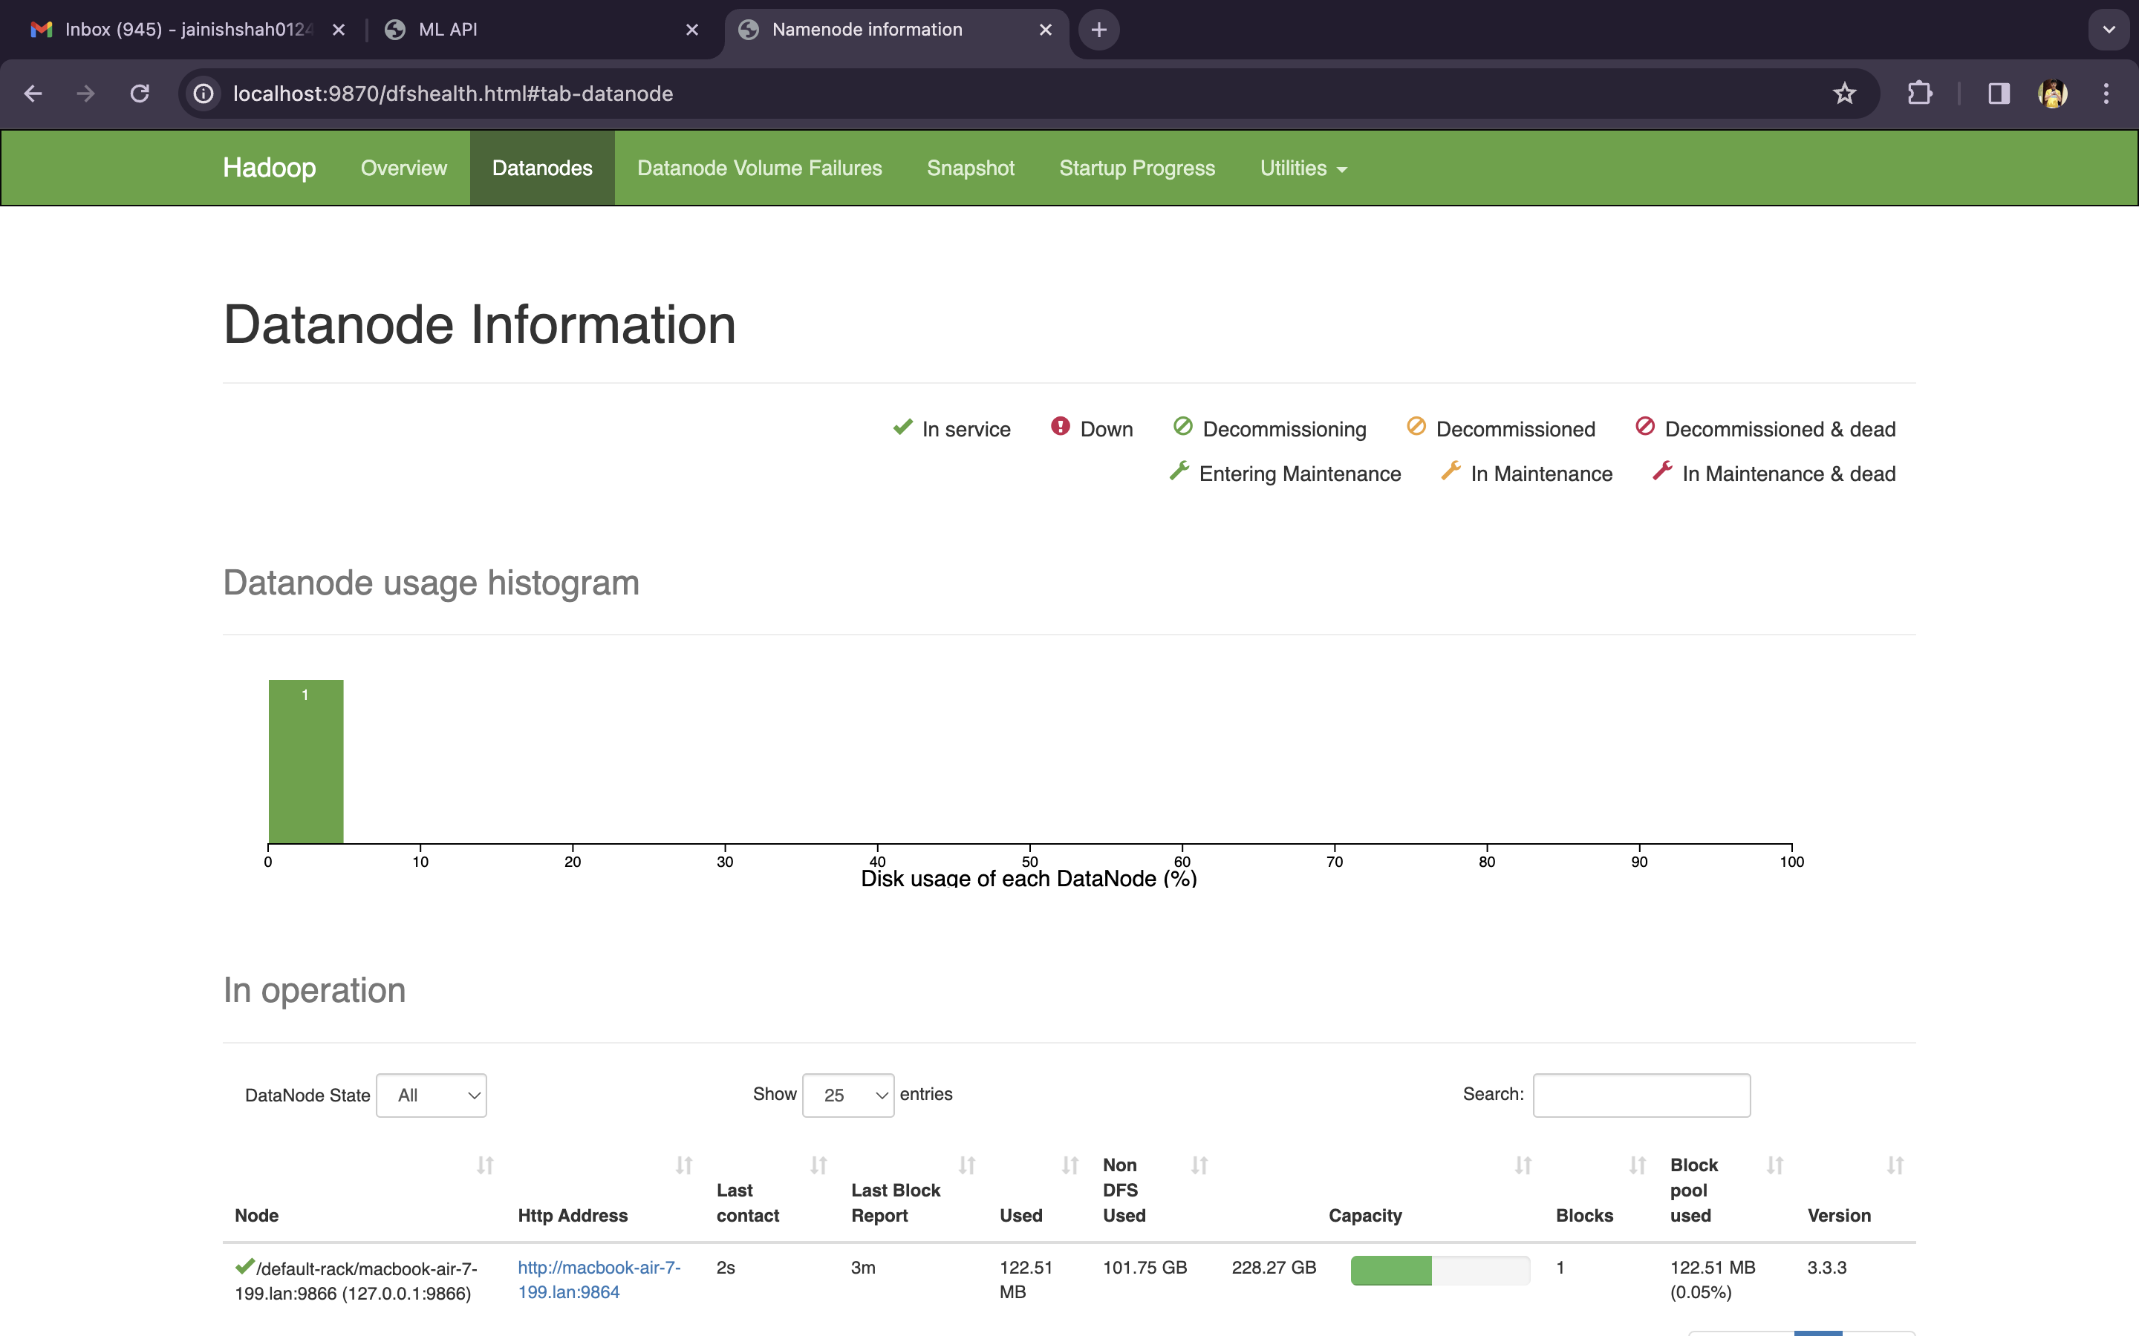

Slide 12
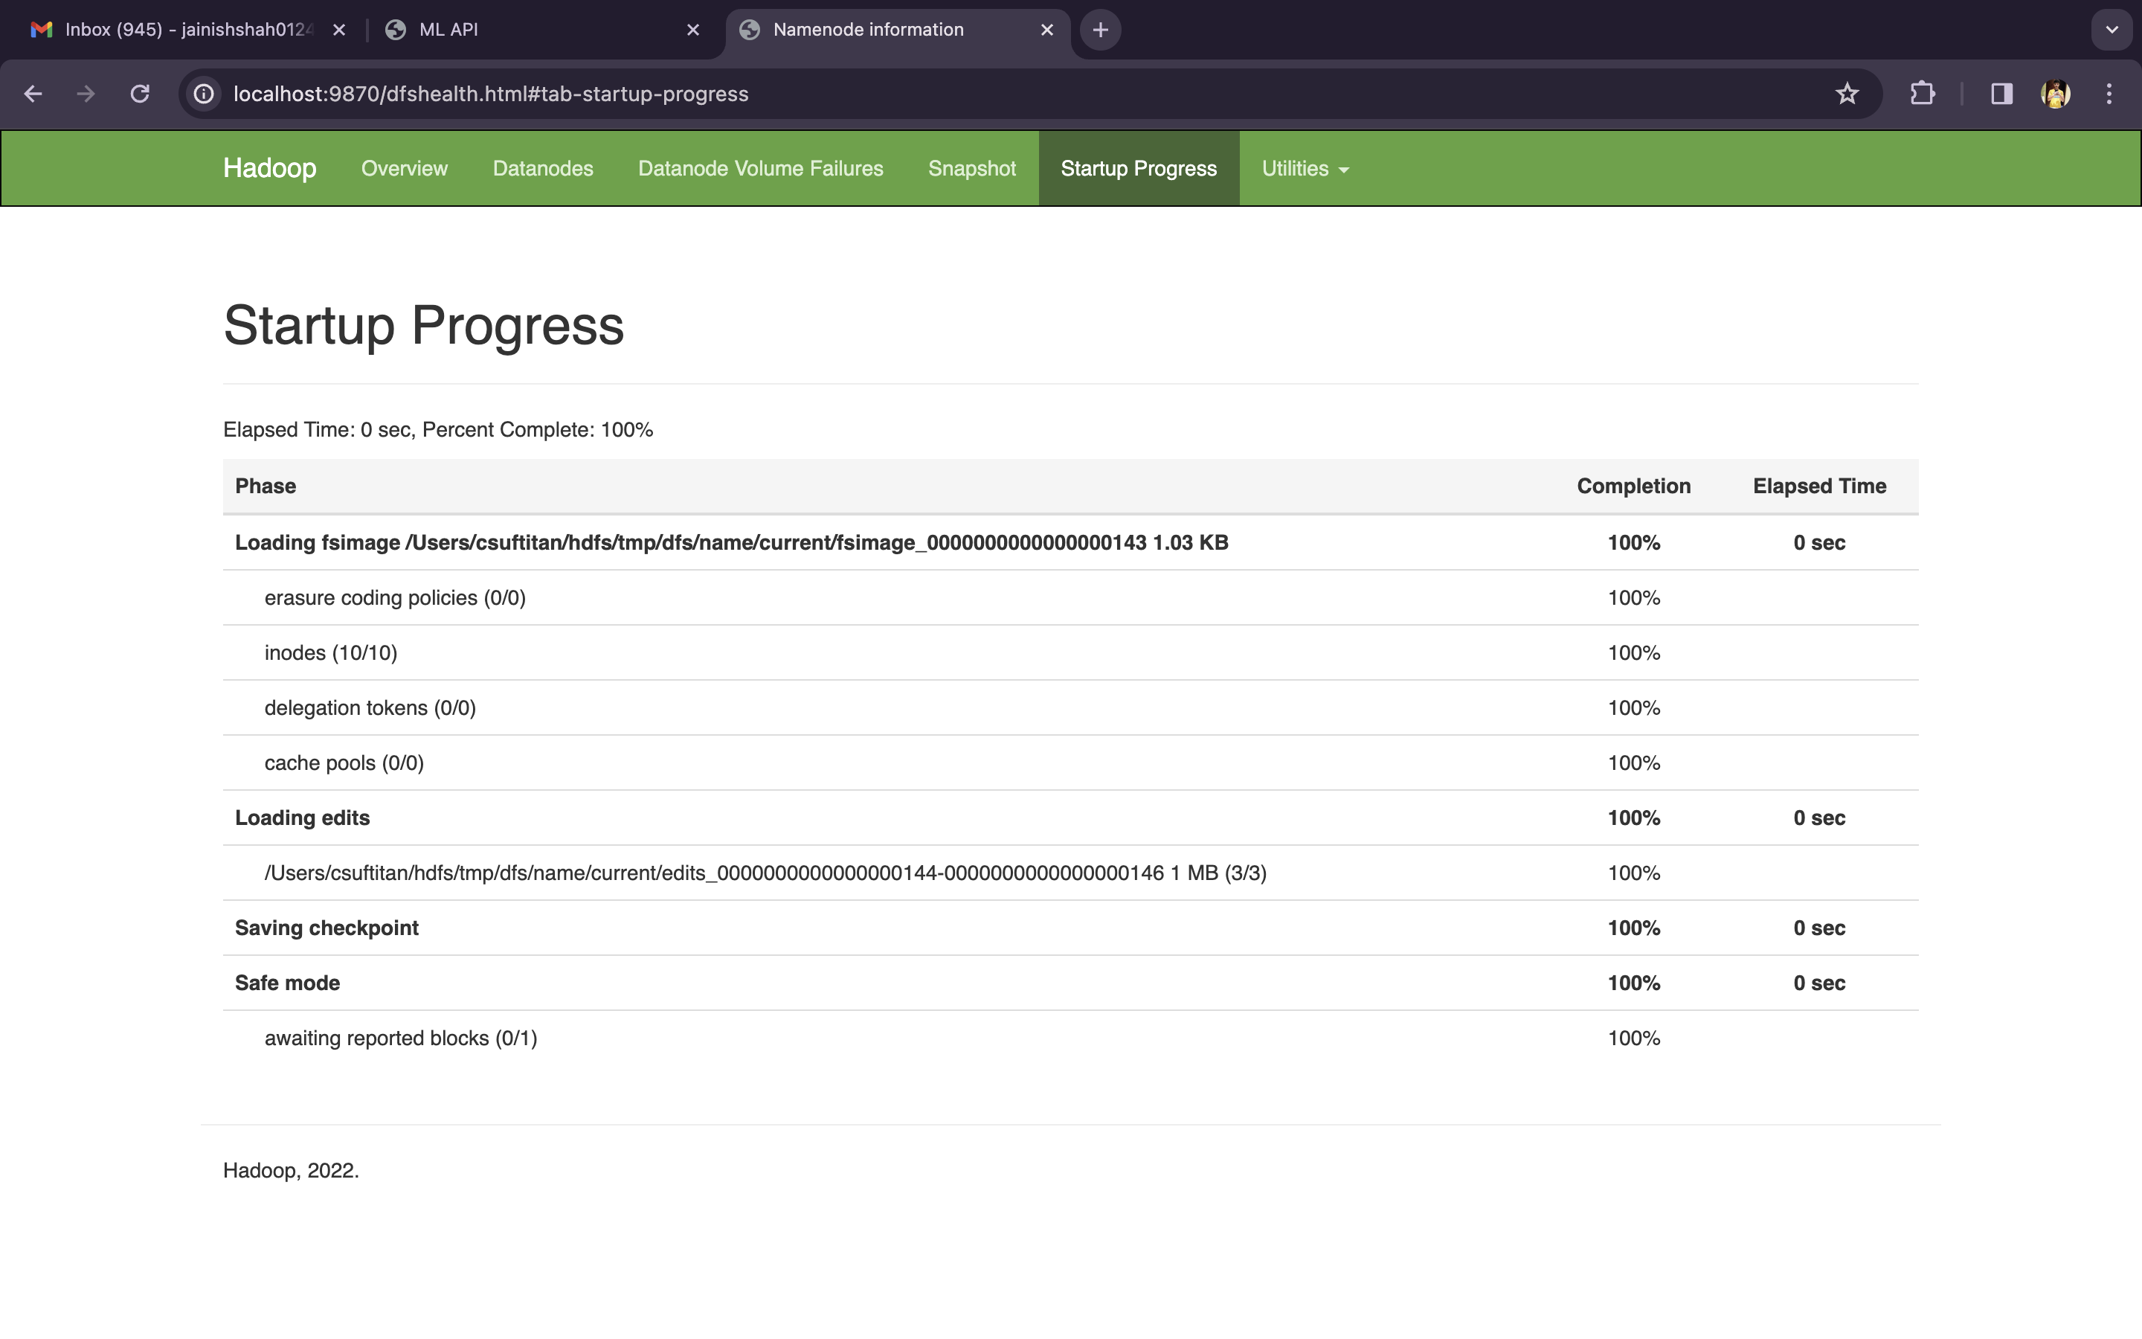

Slide 13
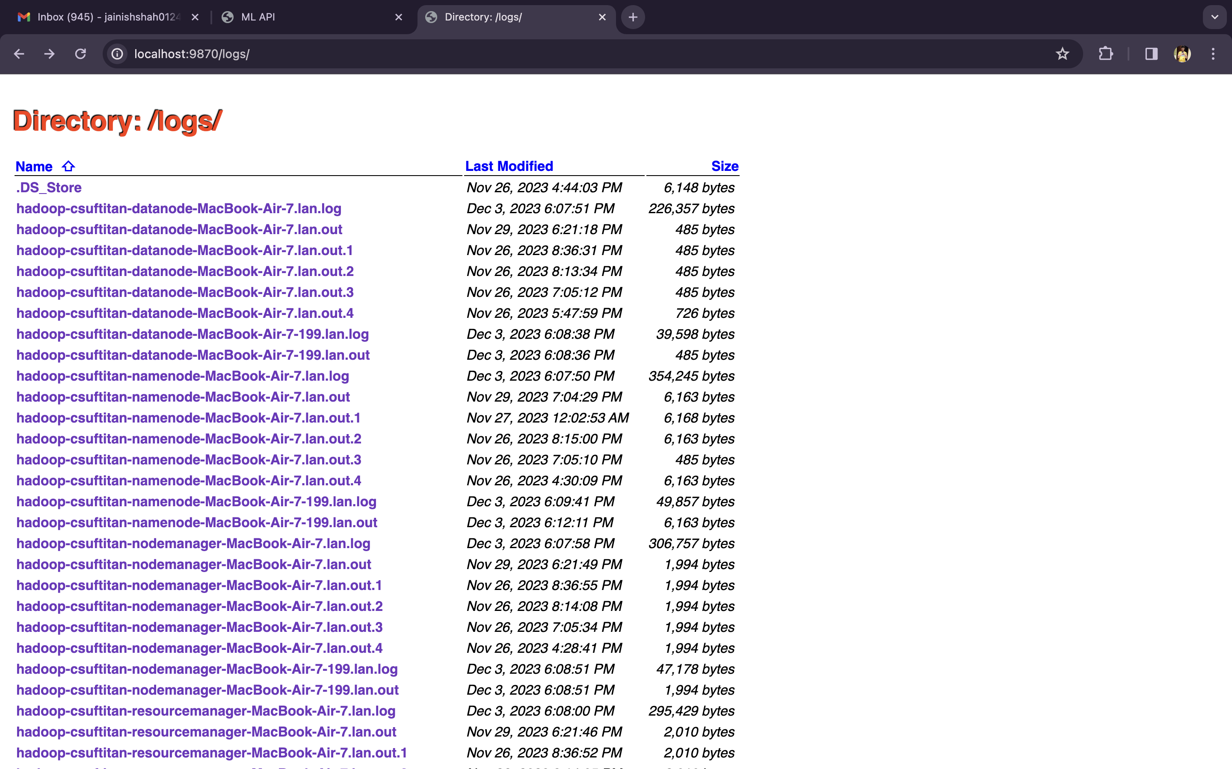

Slide 14
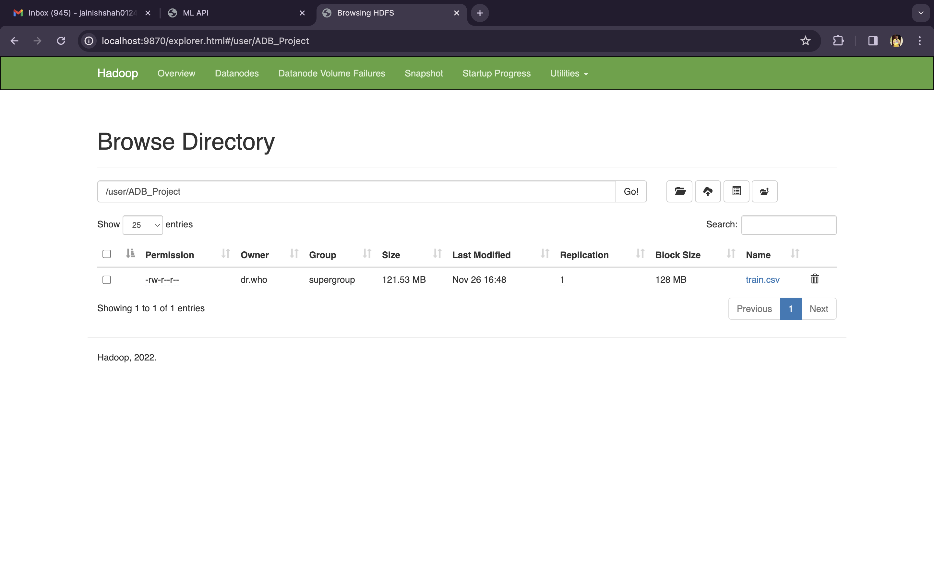

Slide 15
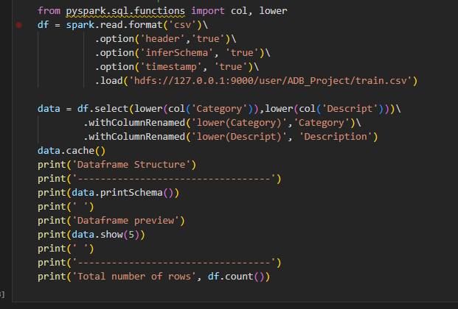
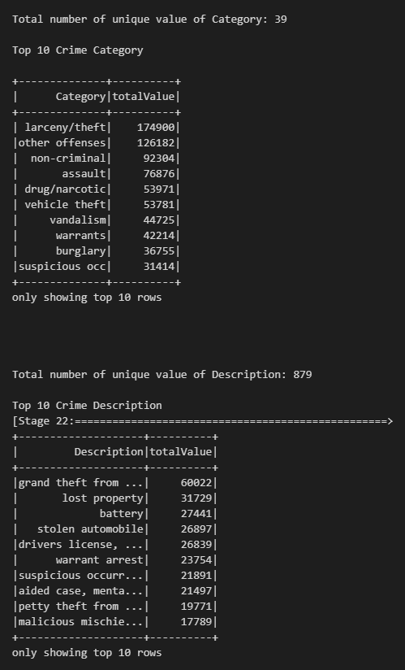
Data From Hadoop

Slide 16
Visualization

Slide 17
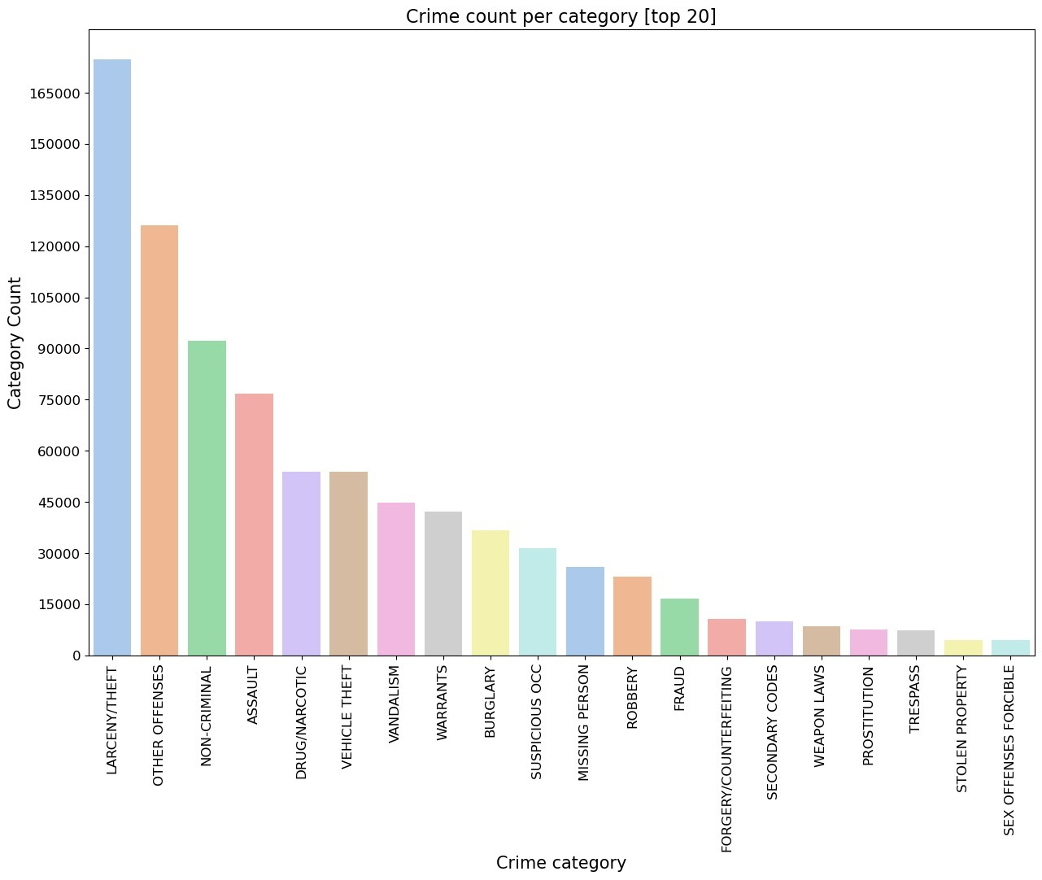
Top 20 Category

Slide 18
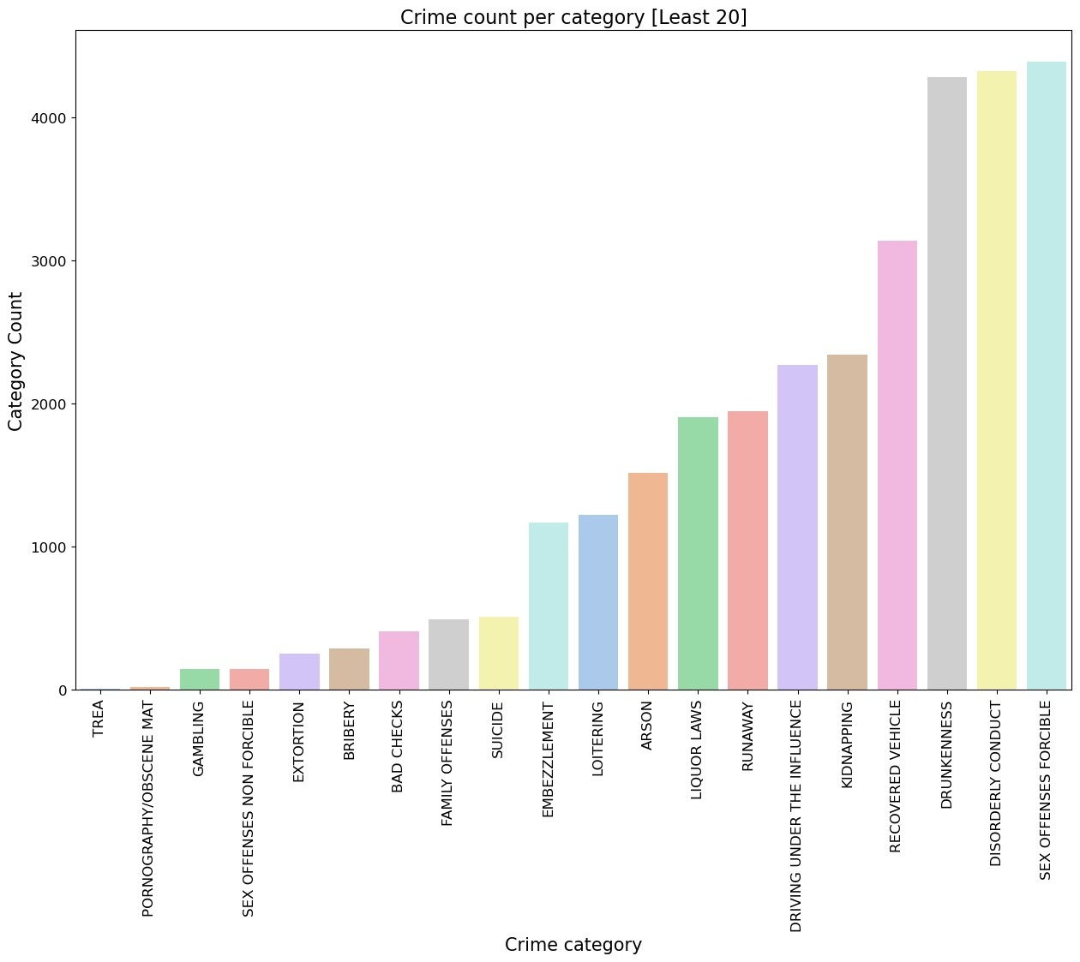
Least 20 Category

Slide 19
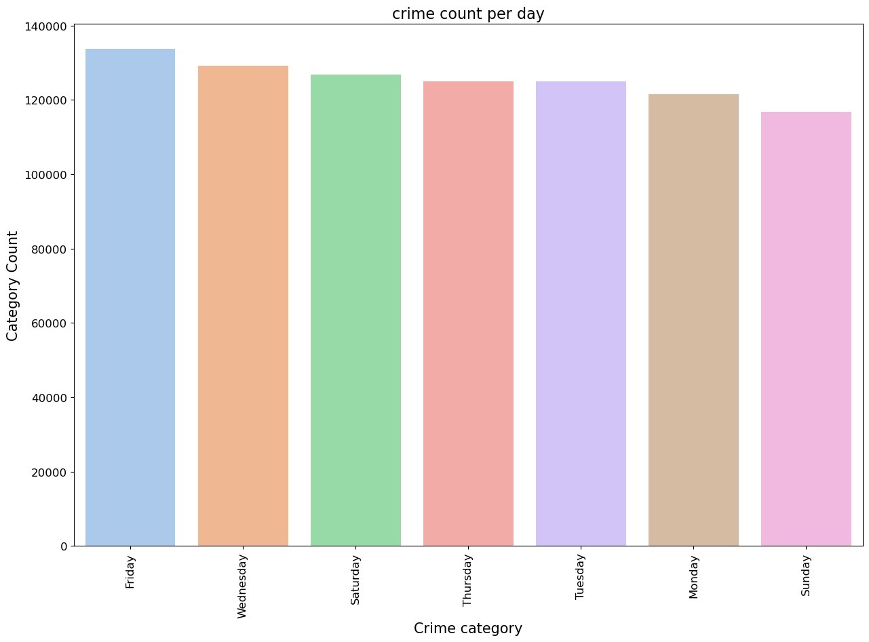
Crime By Days

Slide 20
Method

Slide 21
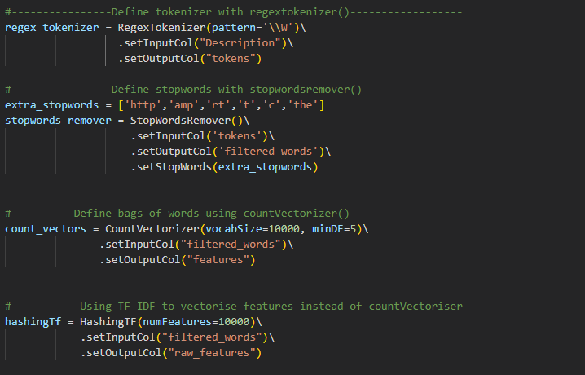
Build Pipeline

Slide 22
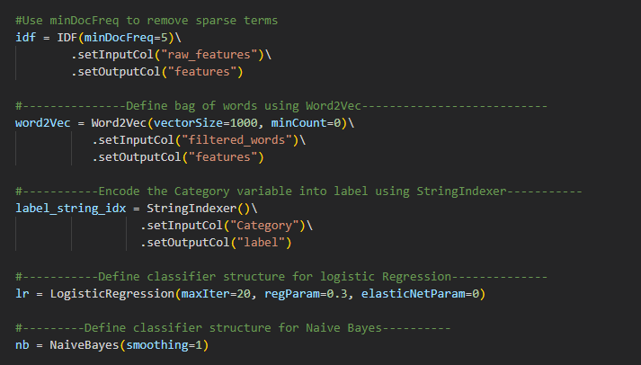

Slide 23
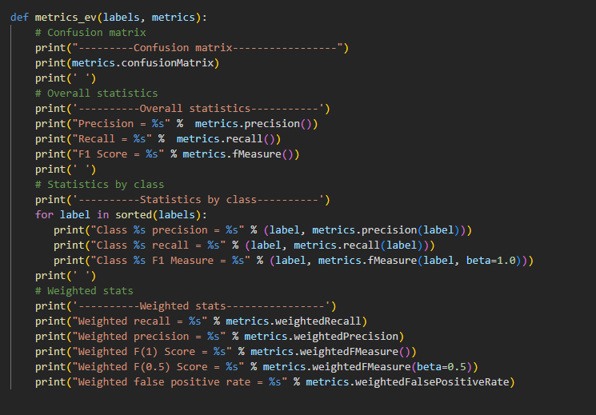
Performance metrics

Slide 24
Models

Slide 25
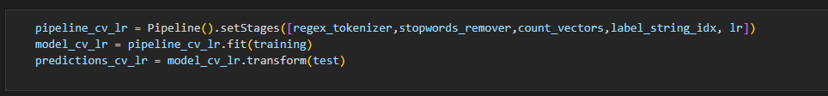
Logistic Regression + Count Vector
Develop a predictive model employing logistic regression.
Utilize the dataset that has been transformed into count vectors as input for the model.
Generate predictions on the test sets using this logistic regression model.
Identify and list the top 10 predictions based on the highest probability assigned by the model.
Evaluate the model's performance using metrics such as accuracy and others.
Ensure the incorporation of the following functions into a pipeline: regex_tokenizer, stopwords_remover, count_vectors, label_string_idx, and lr.

Slide 26
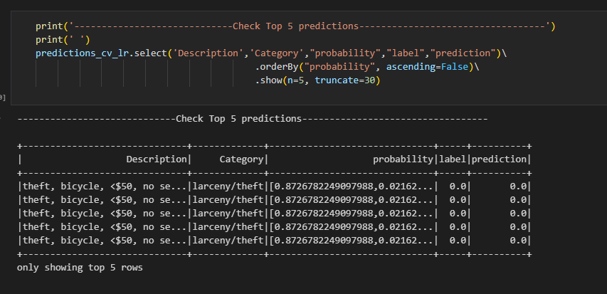
Logistic Regression + Count Vector
Accuracy = 97.23 %

Slide 27

Naive Bayes + Count Vector
Naive Bayes classifiers are a family of probabilistic classifiers.
They are based on the application of Bayes' theorem.
These classifiers make strong (naive) independence assumptions between features.
In the spark.ml implementation, you have support for both multinomial naive Bayes and Bernoulli naive Bayes.
To build a pipeline, you should incorporate the following functions: regex_tokenizer, stopwords_remover, count_vectors label_string_idx, nb

Slide 28
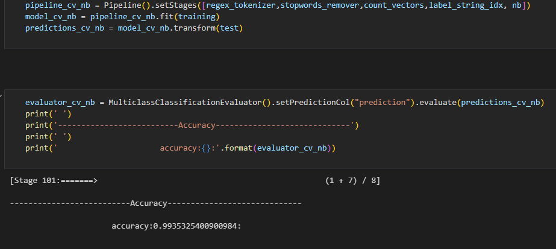
Naive Bayes + Count Vector
Accuracy = 99.35%

Slide 29

Logistic Regression Using TF-IDF
TF-IDF (Term Frequency-Inverse Document Frequency) is a method used in text mining to measure the importance of a term in a document within a larger corpus.
Terms are represented as 't', documents as 'd', and the corpus as 'D'.
Term Frequency (TF) (TF(t, d)) counts how often a term 't' appears in a document 'd'.
Document Frequency (DF) (DF(t, D)) measures the number of documents in the corpus 'D' that contain the term 't'.
Relying solely on term frequency can lead to overemphasizing common words like "a," "the," and "of," which carry little meaningful information.
Different definitions and variants of TF and DF exist, offering flexibility in their application.
In text mining pipelines, functions like regex_tokenizer, stopwords_remover, hashingTF, idf, label_string_idx, and nb are commonly used to streamline the analysis process.

Slide 30
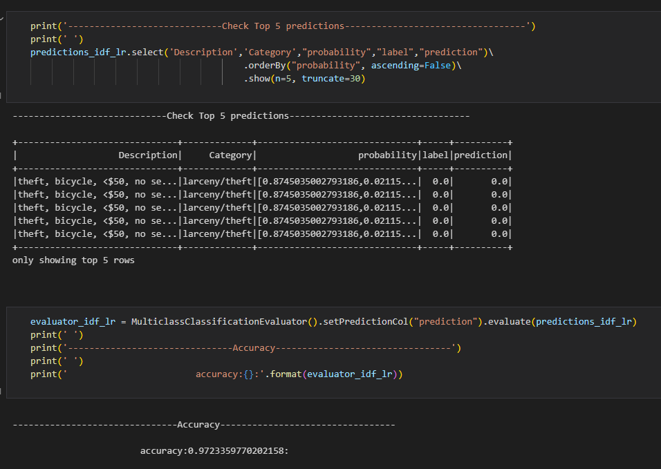
Logistic Regression Using TF-IDF
Accuracy = 97.23%

Slide 31

Saving the model

Slide 32
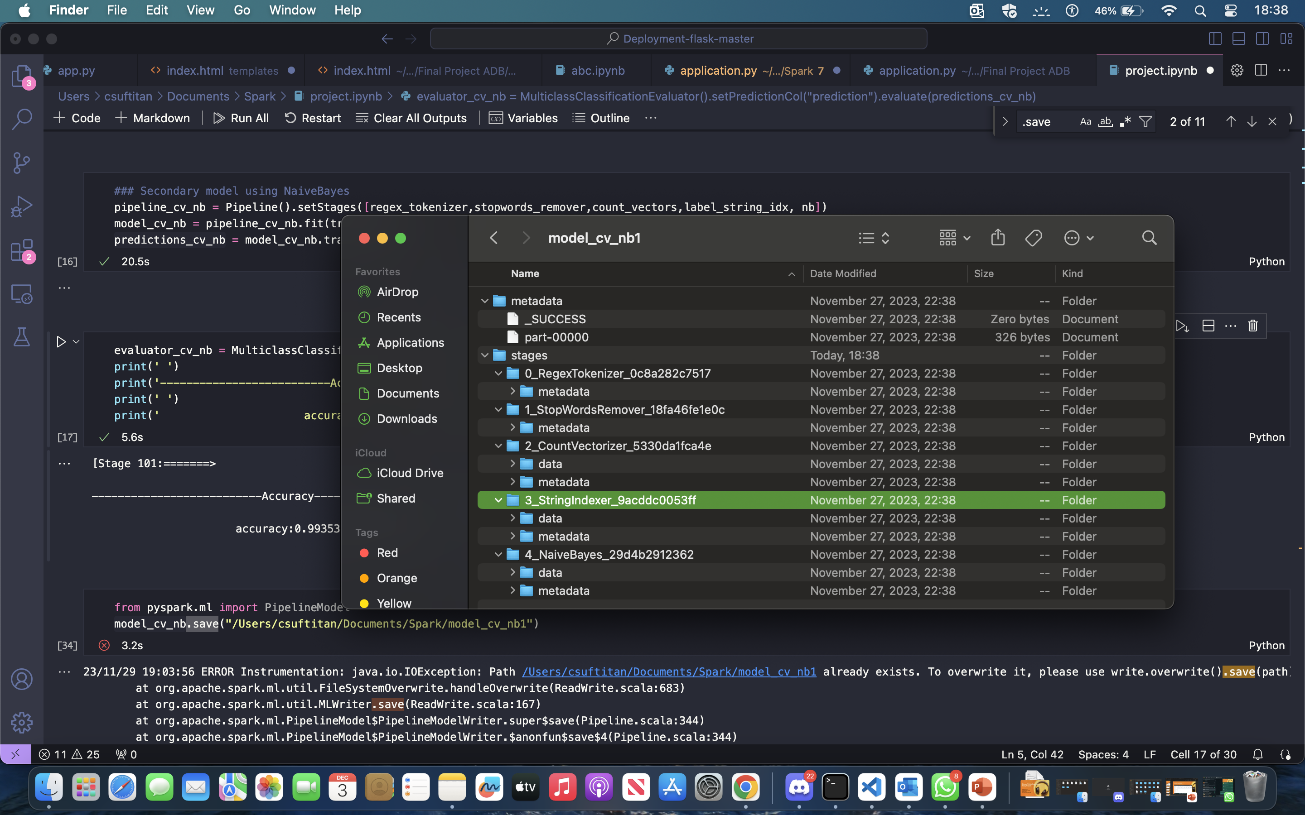

Slide 33
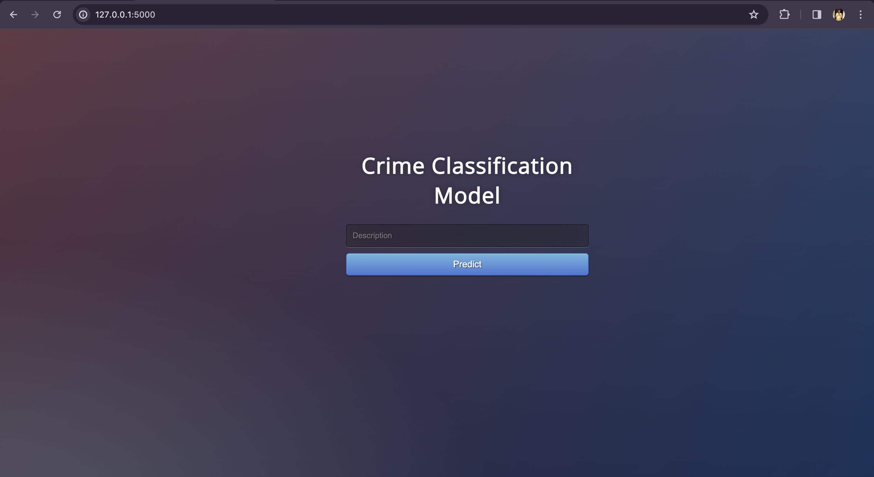
Flask

Slide 34
Examples

Slide 35
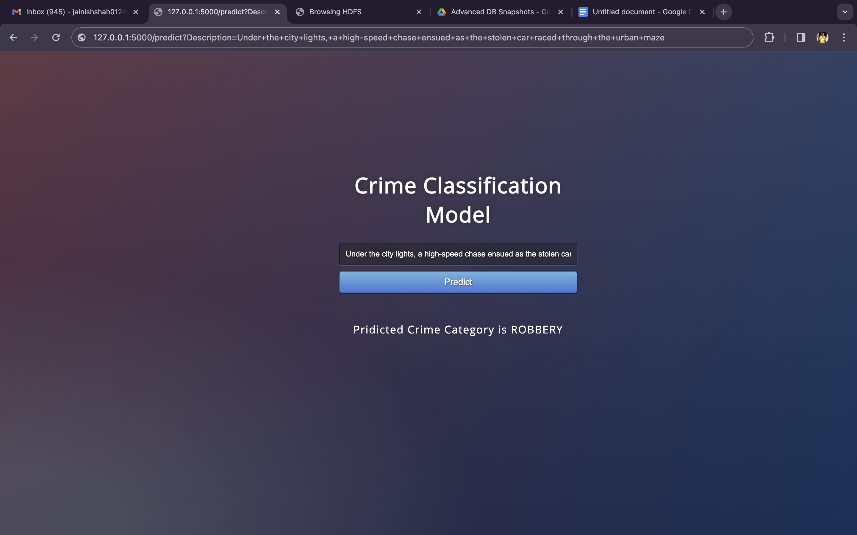
Under the city lights, a high-speed chase ensued as the stolen car raced through the urban maze.

Slide 36
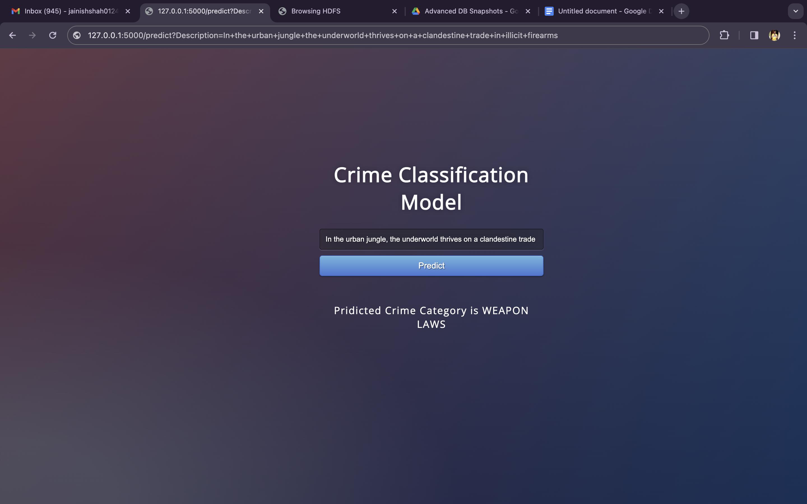
In the urban jungle, the underworld thrives on a clandestine trade in illicit firearms

Slide 37
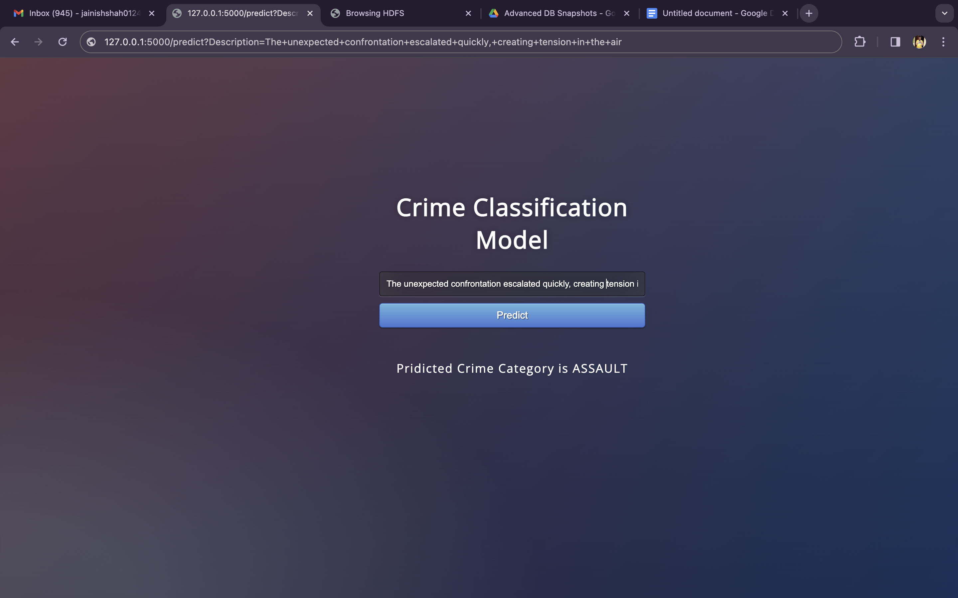
The unexpected confrontation escalated quickly, creating tension in the air.

Slide 38

Thank You

